Slide 1
Dynamic Programming
Longest Common Subsequence

Slide 2
Longest Common Subsequence

Slide 3
What is the longest common subsequence?
The longest common subsequence (LCS) is defined as the longest subsequence that is common to all the given sequences,
provided that the elements of the subsequence are not required to occupy consecutive positions within the original sequences.

Slide 4
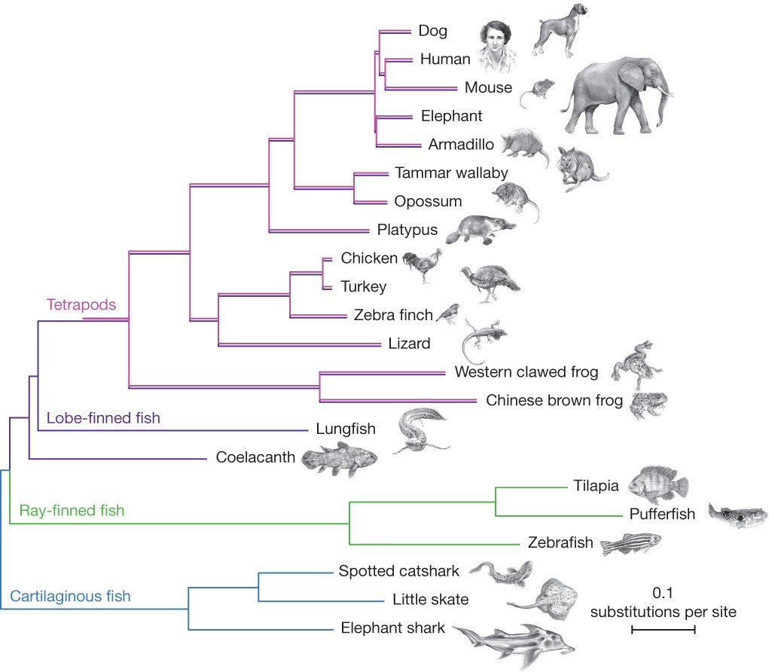
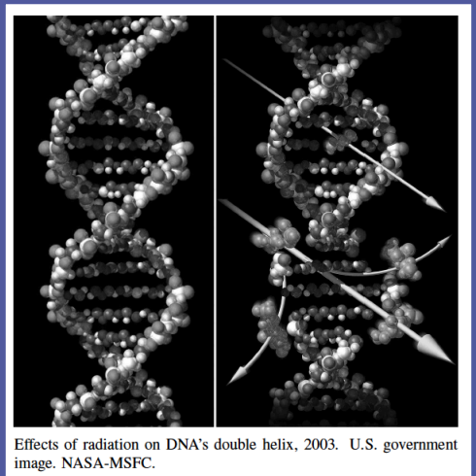
Application of LCS
Sequence Alignment
Genome Comparison
Protein Sequence Analysis
Phylogenetics

Slide 5
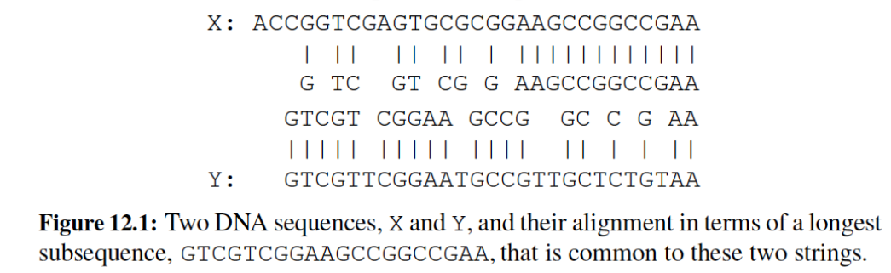
Application - Sequence Alignment
DNA sequences can be viewed as strings of A, C, G, and T characters, which represent nucleotides
Finding the best alignment between two DNA strings involves minimizing the number of changes to convert one string to the other.
Needleman-Wunsch algorithm
Smith-Waterman algorithm

Slide 6
What is a sub sequence?
S1 = {B, C, D, A, A, C, D}
S2 = {A, C, D, B, A, C}
So BC (length 2) is a subsequence of S1 and S2

Slide 7
What is a sub sequence?
S1 = {B, C, D, A, A, C, D}
S2 = {A, C, D, B, A, C}
So DAC (length 3) is a subsequence of S1 and S2

Slide 8
What is a sub sequence?
S1 = {B, C, D, A, A, C, D}
S2 = {A, C, D, B, A, C}
So AAC (length 3) is a subsequence of S1 and S2

Slide 9
What is a sub sequence?
S1 = {B, C, D, A, A, C, D}
S1 = {B, C, D, A, A, C, D}
S1 = {B, C, D, A, A, C, D}
S2 = {A, C, D, B, A, C}
S2 = {A, C, D, B, A, C}
S2 = {A, C, D, B, A, C}
So AC (length 2) is a subsequence of S1 and S2

Slide 10
What is a sub sequence?
S1 = {B, C, D, A, A, C, D}
S2 = {A, C, D, B, A, C}
So CDAC (length 4) is a subsequence of S1 and S2

Slide 11
Characteristics of a subsequence that we can understand from the previous examples
A subsequence can be obtained from two strings if:
We match character with character.
We keep on matching while going in the same direction.
We keep/do not keep any gap between characters. (i.e. the characters do not have to be consecutive)
Following the above steps we obtained these subsequences (in prev slides):
ACD BC DAC AAC AC CDAC
Longest Common Subsequence

Slide 12
Defining the LCS problem
What is the length of the longest common subsequence of the two strings ABCX and BZX
LCS(ABCX,BZX)
=
(which we will solve using dynamic programming)

Slide 13
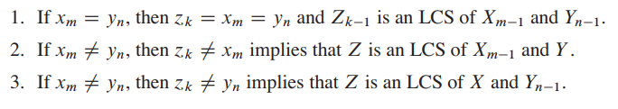
Optimal substructure of an LCS
Let X ={x1, x2,.....xm} and Y = {y1, y2,.....,yn} be sequences,
and let Z = {z1, z2, …., zk} be any LCS of X and Y .

Slide 14

The Recursive Equation

Slide 15
The Recursive Equation
Last characters are eq
(i-1,j-1)
i-1,j
Last char not equal
Last char not equal
i,j-1
(i,j)

Slide 16
The Bottom Up Approach
A G G T A B
6
0
1
2
3
4
5
0
1
2
3
4
5
0
0
0
0
0
0
0
0
0
G
0
0
1
1
1
1
1
1
1
X
0
0
1
1
1
1
1
2
2
T
0
0
1
1
2
2
2
3
3
X
4
0
0
1
1
2
2
2
4
A
5
0
1
1
1
2
3
3
T
6
0
1
1
1
2
3
3
B
7
0
1
1
1
2
3
4

Slide 17
The Bottom Up Approach
A G G T A B
6
0
1
2
3
4
5
0
1
2
3
4
5
0
0
0
0
0
0
0
0
0
G
0
0
1
1
1
1
1
1
1
X
0
0
1
1
1
1
1
2
2
T
0
0
1
1
2
2
2
3
3
X
4
0
0
1
1
2
2
2
4
A
5
0
1
1
1
2
3
3
T
B
T
6
0
1
1
1
2
3
3
G
A
B
7
0
1
1
1
2
3
4

Slide 18
The Bottom Up Approach (Tracking)
A G G T A B
0
1
2
3
4
5
6
0
1
2
3
4
5
0
0
0
0
0
0
0
0
0
G
0
0U
1C
1C
1L
1L
1L
1
1
X
0
0U
1U
1U
1U
1U
1U
2
2
T
0
0U
1U
1U
2C
2L
2L
3
3
X
4
0
0U
1U
1U
2U
2U
2U
4
A
5
0
1C
1U
1U
2U
3C
3L
T
6
0
1U
1U
1U
2C
3U
3U
B
7
0
1U
1U
1U
2U
3U
4C

Slide 19
The Bottom Up Approach (Tracking)
A G G T A B
0
1
2
3
4
5
6
0
1
2
3
4
5
0
0
0
0
0
0
0
0
0
G
0
0U
1C
1C
1L
1L
1L
1
1
X
0
0U
1U
1U
1U
1U
1U
2
2
T
0
0U
1U
1U
2C
2L
2L
3
3
X
4
0
0U
1U
1U
2U
2U
2U
4
A
0
1C
1U
1U
2U
3C
3L
4
3
4
B
T
4
0
1U
1U
1U
2C
3U
3U
G
T
A
4
B
4
0
1U
1U
1U
2U
3U
4C
4

Slide 20
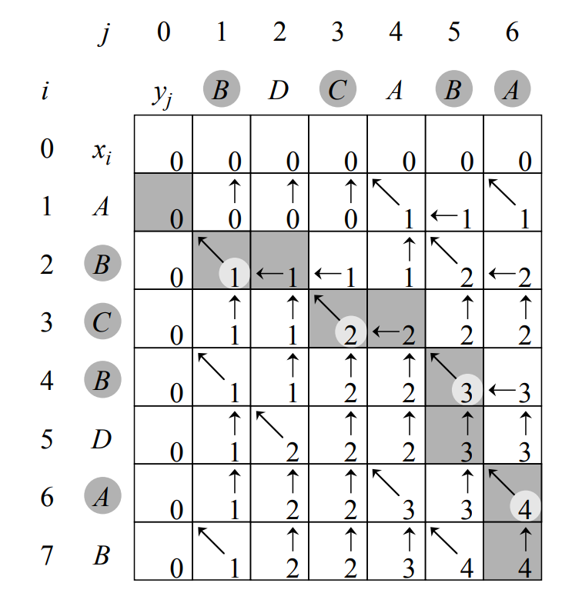
Bottom Up Approach
Solve:
S1=ABCBDAB
S2=BDCABA

Slide 21
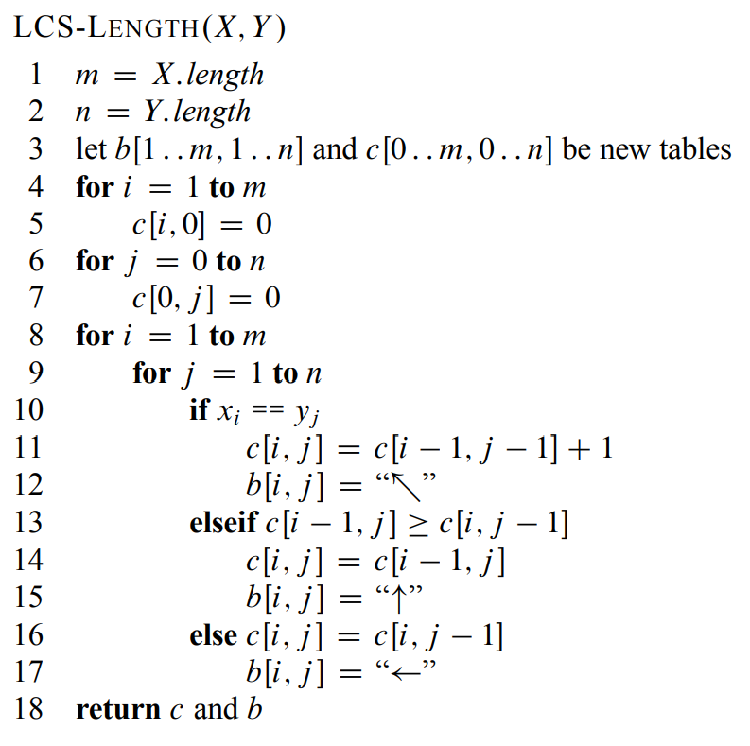
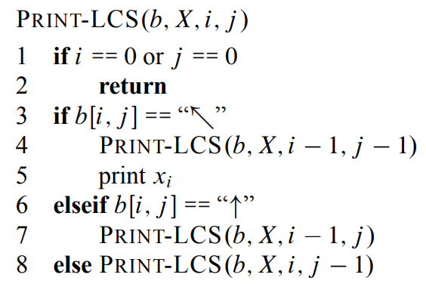

Slide 22
Thank You

